Slide 1
Unit 202: Principles of electrical science
Levers

Slide 2
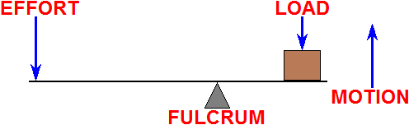

Levers
Class 1. Fulcrum in the middle: the effort is applied on one side of the fulcrum and the resistance on the other side; for example, a crowbar or a pair of scissors.

Slide 3
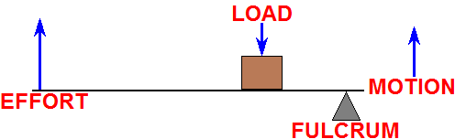

Levers
Class 2. Resistance in the middle: the effort is applied on one side of the resistance and the fulcrum is located on the other side; for example, a wheelbarrow or a nutcracker or a bottle opener.

Slide 4
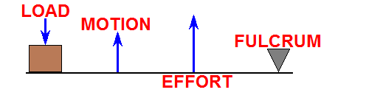

Levers
Class 3. Effort in the middle: the resistance is on one side of the effort and the fulcrum is located on the other side; for example, a pair of tweezers or the human mandible.

Slide 5

Levers
Lever calculations

Slide 6
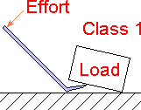
Levers
EXAMPLE 1. A crowbar is used to lift a packing case. The load exerted by the packing case is 1,200N. Determine the effort needed to lift the packing case if the load is 10cm from the pivot and the effort is 1.0m from the pivot.
Effort | = | Load × Load to fulcrum distance
 |  | Effort to fulcrum distance
 | = | 1,200 × 0.1
 |  | 1
 | = | 120N

Slide 7
Levers
EXAMPLE 2. A horizontal bar 1.75m in length is pivoted at a point 0.75m from one end and a downward force of 150N is applied at right angles to this end of the bar. Calculate the force that must be applied to the other end of the bar to maintain it in a horizontal position. Ignore the weight of the bar.

Slide 8
Levers
EXAMPLE 2. A horizontal bar 1.75m in length is pivoted at a point 0.75m from one end and a downward force of 150N is applied at right angles to this end of the bar. Calculate the force that must be applied to the other end of the bar to maintain it in a horizontal position. Ignore the weight of the bar.
Effort | = | Load × Load to fulcrum distance
 |  | Effort to fulcrum distance
 | = | 150 × 0.75
 |  | 1
 | = | 112.5N

Slide 9
Levers
EXAMPLE 2. A horizontal bar 1.75m in length is pivoted at a point 0.75m from one end and a downward force of 150N is applied at right angles to this end of the bar. Calculate the force that must be applied to the other end of the bar to maintain it in a horizontal position. Ignore the weight of the bar.

Slide 10
Gears
Gears are used for transmitting power from one part of a machine to another. For example, an electric motor in a factory transferring power via the gear train to piece of equipment being driven.
You can have any number of gears connected together and they can be in different shapes and sizes. Each time you pass power from one gear wheel to another, you can do one of three things:
Increase/decrease speed
Increase/decrease force
Change direction.

Slide 11
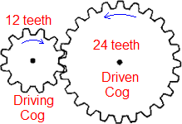
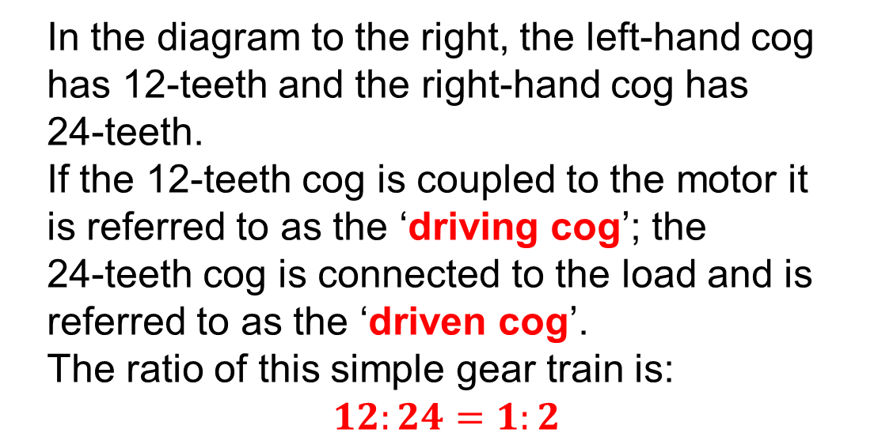
Gears
The amount by which a pair of gears increases or decrease speed or power depend on the ratio between the two gears which can be found simply by counting the number of teeth on each.
In the diagram to the right, the left‑hand cog has 12‑teeth and the right‑hand cog has 24‑teeth.
If the 12‑teeth cog is coupled to the motor it is referred to as the ‘driving cog’; the 24‑teeth cog is connected to the load and is referred to as the ‘driven cog’.
The ratio of this simple gear train is:
$$12:24=1:2$$

Slide 12
Gears
Very simply, if the driving cog is smaller than the driven cog then there will be a reduction in speed of the driven cog according to the gear ratio. In the example above, the 12‑teeth driving cog would have to rotate twice for every single rotation of the driven cog so speed would be reduced by a half. However, there would be twice as much power available in this case at the driven cog despite going slower.
Also, note that if the driving cog rotates clockwise the driven cog will rotate anti‑clockwise. I direction of rotation is crucial an extra cog, called an ‘idler cog’, is placed between the driving and driven cogs to restore the direction of rotation.

Slide 13
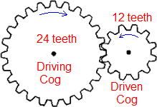
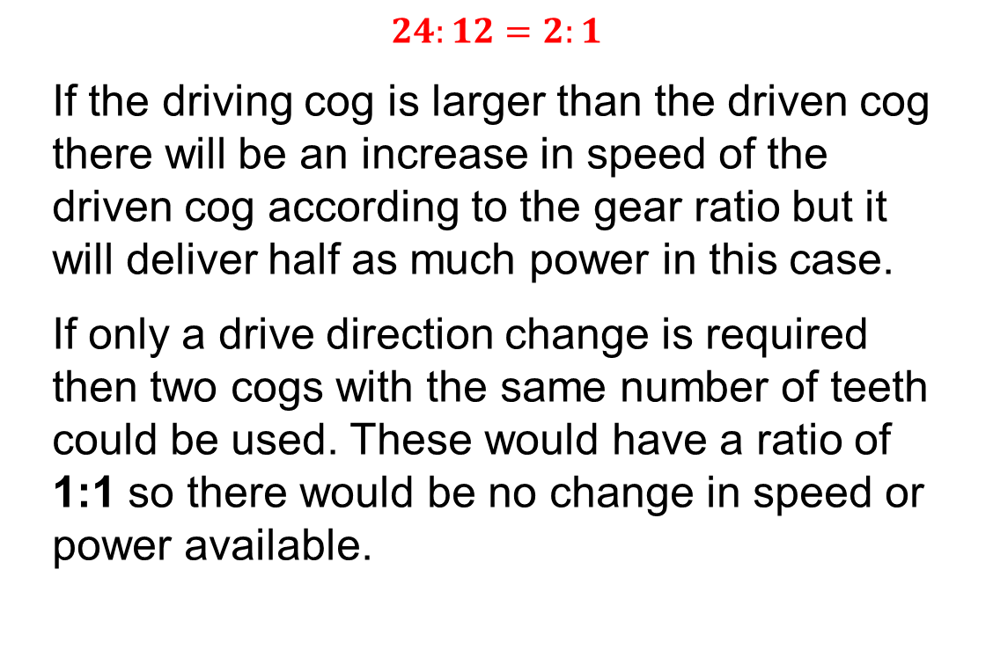
Gears
In this example, the larger 24‑teeth cog is now the driving cog and the smaller 12‑teeth cog is now the driven cog.
The ratio of this simple gear train is:
$$24:12=2:1$$
If the driving cog is larger than the driven cog there will be an increase in speed of the driven cog according to the gear ratio but it will deliver half as much power in this case.
If only a drive direction change is required then two cogs with the same number of teeth could be used. These would have a ratio of 1:1 so there would be no change in speed or power available.

Slide 14
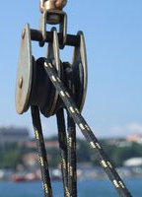
Pulleys
A pulley is simply a collection of one or more wheels over which you loop a rope to make it easier to lift things.
Pulleys help us multiply forces and are examples of what scientists call simple machines.
The more wheels you have, and the more times you loop the rope around them, the more you can lift.
The only drawback with using pulleys is that whilst you can lift heavier loads you have to pull the rope further as can be seen on the following page.

Slide 15
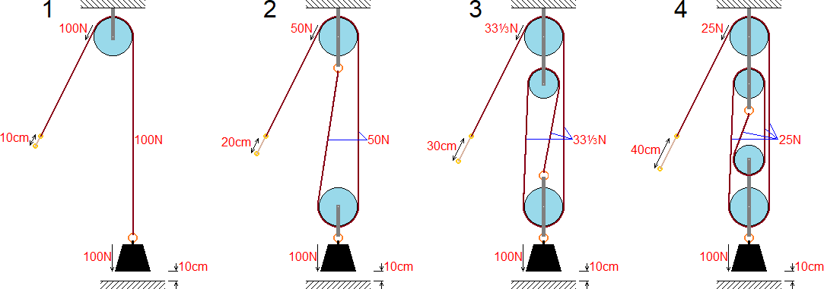
Pulleys

Slide 16
Unit 202: Principles of electrical science
The End

